Slide 1
Self-Care Choice Board
Educator Care Card
Guided meditation
Safe place visualization
Journaling
Mandala Coloring pages
Zumba
Distraction Skills
Call the EAP:
866-327-2400
Self-Soothing Skills
Yoga for Stress Relief
Notes:
The stress that teachers face is reaching epidemic proportions. According to a 2017 study released by the American Federation of Teachers, teachers report finding their work stressful 61 percent of the time, as compared to the general public, who find their work stressful 30 percent of the time. Worse, a 2018 study by the University of Missouri found that 93 percent of elementary school teachers report a high stress level. Today, teaching is one of the most stressful occupations in the U.S. Teacher stress impacts teacher health and well-being, work attitudes (e.g. job satisfaction), and turnover. High stress levels are causing teachers to leave their profession, which causes instability among staff, students, and the community. Nationally, 45 percent of teachers leave the profession within five years of teaching. And this is all BEFORE COVID!
Self-care assessment: https://drive.google.com/file/d/1FWex7Yg_WI4VpHOMQ9l5oz0231YYWsQ_/view
Self-care plan: https://drive.google.com/file/d/19WNO49_xgeWtZcrcygolXUwxWFGCFgC1/view
Bingo Card Maker: https://myfreebingocards.com/bingo-card-generator/edit/cxw4at

Slide 2
Mindfulness…
Mindful walking
Breathing
Connecting to your senses
Mindful movement
Pausing between actions
Mindful eating
Active meditation
Emotional/thought observation
Mindful adventures
Mindfulness is a state of active, open attention to the present. This state is described as observing one’s thoughts and feelings without judging them as good or bad.
Notes:
Live in the moment!
Set an alarm for 5-10 minutes and challenge yourself to focus on one task. Don’t switch to check email, go on social media, until the alarm goes off.
Take a walk through your neighborhood or a park. Count 5 things that you can see, 4 things you can hear, 3 things you can touch, 2 things you can smell.
Eating is one of the most enjoyable parts of our day. Close your eyes so you notice the texture and flavor of food.

Slide 3
Three-Step Mindful Breathing
Tired?
Nostril Breathing
Using your thumb block one side of your nose and inhale through the other side.
At peak inhalation, block off that nostril and switch
Continue until you feel energized
Stressed?
Abdominal Breathing
Place one hand on your chest and the other on your belly
Inhale slowly, making sure the air is filling your abdomen ad not your chest
Perform 6-10 counts for 10 minutes
Notes:
Two types of breathing-one is better for waking you up when you are feeling tired. The other works to decrease stress.

Slide 4
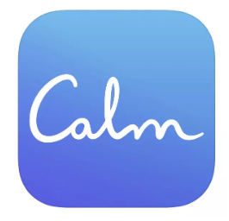
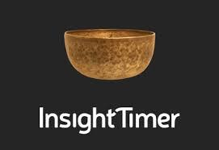
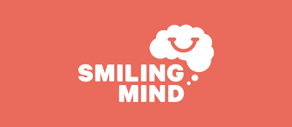
Mindfulness Apps
Notes:
Insight Timer (FREE) has an insanely huge library of content: over 25,000 guided meditations from around 3,000 teachers on topics like stress, relationships, creativity, and more.
Smiling Mind (FREE) This app features hundreds of meditations and has a variety of specialized programs for educators. Interspersed with the meditations are audio instructions for “activities” with catchy names like Are You Really Listening?, A Legal Alien, and Finding Your Inner Master. In Are You Really Listening?, for example, you learn to treat other people’s speech as an object of meditation, focusing on what they are saying and bringing your attention back when it wanders to your own thoughts.
Stop, Breathe & Think wants to create a more deliberate, intentional experience. A section called Learn to Meditate explains what mindfulness is and why it’s beneficial, including some of the neuroscience and physiology behind it. Each day when you open the app, you’re asked “How are you?” and invited to check in with yourself—to rate your mind and body on a scale of “rough” to “great,” and note up to five emotions you’re feeling. Then, Stop, Breathe & Think will recommend meditations, mindful walks, and even acupressure videos tailored to how you feel.
10% Happier ( free trial) The tagline for 10% Happier tells you the most important thing you need to know about the app. It’s “meditation for fidgety skeptics”—a relatable, no-nonsense way to learn mindfulness for people whose goals veer more toward sharpening their brains than befriending their souls. Unlike some other mindfulness apps, 10% Happier comes with a tour guide. Dan Harris is a news anchor who famously had a panic attack on live TV, an experience that eventually led him to pursue meditation.
Calm (free trial) This award-winning app has calming exercises, breathing techniques to help you relax, and even a Calm Kids section with meditations for kids between 3 and 17. The Sleep Stories section features a great mix of voice talent — you may recognize actors Matthew McConaughey or Jerome Flynn — to lull you to sleep. For a mindful experience you can access right from your Apple Watch, there are new breathing exercises, a mindful walking meditation, and calming exercises.

Slide 5
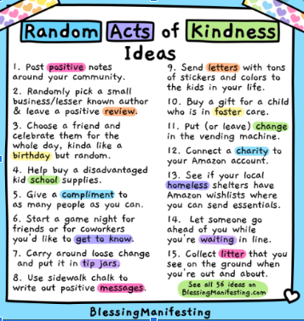
Pick three and do them when you feel the moment is right.

Slide 6
Get Some Sleep
Listen to some soothing music or background noise while you try to fall asleep.
Try to go to sleep and get up at the same time every day.
Avoid sleeping in—even on weekends.
Avoid screens within 1-2 hours of your bedtime.
When it’s time to sleep, make sure the room is dark.
Get out in nature or exercise during the day.
A cold bedroom is best for sleeping.
Notes:
It is easy to think about sleep as a time when your body and brain temporarily shuts off. The truth is, however, during rest your brain is hard at work overseeing a wide variety of biological upkeep and preparing for the next day. More specifically, adequate sleep is necessary to:
Stay Alert. Good sleep allows your mind to regain focus and tackle those tricky mental challenges. It can also stimulate creativity.
Boost Memory. Sleeping is the most important time to shape memories and make the connections between events, feelings and experiences. In fact, sleep is a requirement to form new learning and memory pathways in the brain.
Fight Infection. Sleep is your body’s mechanism to ward off infection. When you don’t get enough, your immune system is weaker, making you more susceptible to illness.
Be Active. Energy levels after healthy sleep are higher, and your mental awareness is more acute. Good sleep is also tied to
Improved athletic performance, including greater speed, agility and reflexes.
Replenish. During sleep, your body repairs the damage caused by stress, ultraviolet rays and other harmful exposure, as well as muscle injuries and other traumas.
When you don’t get enough sleep over time, not only do you lose out on the key benefits of sleep, but you also become more vulnerable to a number of short- and long-term health risks.

Slide 7
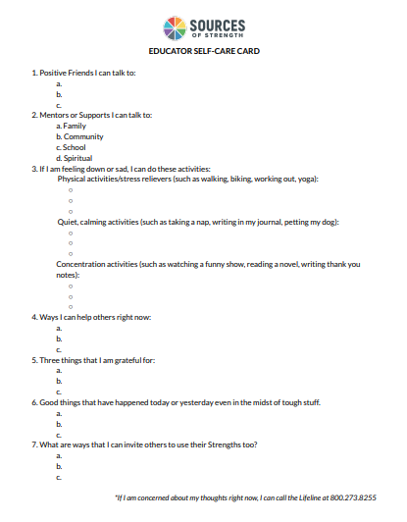
Educator Care Card
Print out the Educator Care Card.
When you’re ready to reflect. Fill out this Educator Care Card.
Put it in a place where you can easily refer to it when you’re in distress or feeling overwhelmed.
Remember: You’re not in this alone. We are here to support one another.

Slide 8
Guided Meditation for Stress Relief
Find a place that is free from distractions.
Post a “Do Not Disturb” sign on your door.
Sit in a comfortable, upright position.
Click the link above.
Close your eyes and listen to the guided meditation.
Congratulate yourself for taking care of you!

Slide 9
Safe Place Visualization
Find a place that is free from distractions.
Post a “Do Not Disturb” sign on your door.
Sit in a comfortable, upright position.
Click the link above.
Close your eyes and listen to the guided meditation.
Congratulation yourself for taking care of you!

Slide 10
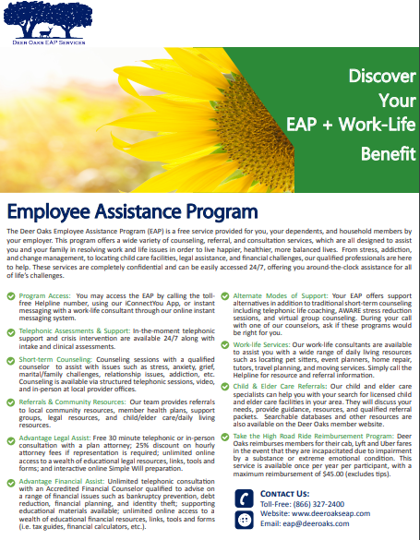
Call EAP
866-327-2400
Short term counseling
24/7 phone counseling and crisis services
Financial service
Child and Elder care referrals
Transportation refunds
So much more...

Slide 11
Tips for Journaling:
Add journaling to your daily routine.
Make your journal easy to access.
Be honest, your journal is just for you.
From time to time, re-read your journal.
Date your entries.
Do what resonates with you.
Try not to stress over your journal!
Gratitude Journal
Suggested Journal Prompt:
List 20 things you are grateful for.
Notes:
https://medium.com/@thesunshinesuitcase/30-journal-prompts-for-anxiety-and-depression-repost-1763b3d5ac01

